Slide 1
Large Scale Propagation Model

Slide 2
Propagation Model
Propagation models are used for:
Predicting the average signal strength at a given distance from the transmitter
Estimating the variability of the signal strength in close spatial proximity to a particular locations
Can be categorized into two types:
Large-scale propagation models
Small-scale propagation models

Slide 3
Large Scale Propagation Model:
Predict the mean signal strength for an arbitrary transmitter-receiver(T-R) separation.
Estimate radio coverage of a transmitter
Characterize signal strength over large T-R separation distances (several 100’s to 1000’s meters)
Small Scale Propagation Model:
Characterize rapid fluctuations of received signal strength over
Very short travel distances ( a few wavelengths)
Short time durations (on the order of seconds)

Slide 4
Multipath Propagation Mechanism
There are three basic propagation mechanisms in addition to line-of-sight paths:
Reflection
Diffraction
Scattering

Slide 5
Reflection - occurs when signal encounters a surface that has large dimension relative to the wavelength of the signal.
Diffraction – occurs at the edge of an impenetrable body that is large compared to the wavelength of the radio wave. When a radio wave encounters such an edge, waves propagate in different directions with the edge as the source.
Scattering – occurs when incoming signal hits an object whose size in the order of the wavelength of the signal or less.
Notes:
Reflection, diffraction, and scattering are the three basic propagation mechanisms which impact propagation in a mobile communication system.
Diffraction: When a radio wave encounters such an edge, waves propagate in different directions with the edge as the source. The surface has large dimension compared to wavelength of radio wave.
Scattering: An incoming signal is scattered into several weaker outgoing signals. Example lampost, traffic sign.

Slide 6
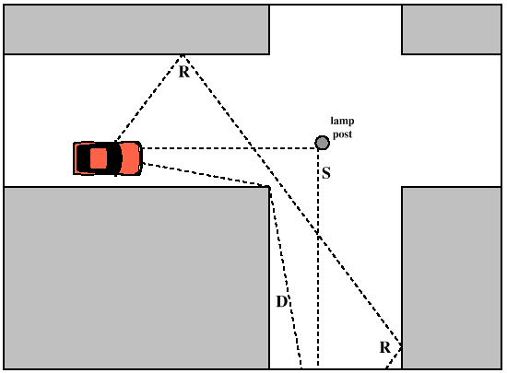
Multipath Propagation
Notes:
Multiple copies of a signal may arrive at different phases
If phases add destructively, the signal level relative to noise declines, making detection more difficult
Intersymbol interference (ISI)
One or more delayed copies of a pulse may arrive at the same time as the primary pulse for a subsequent bit

Slide 7
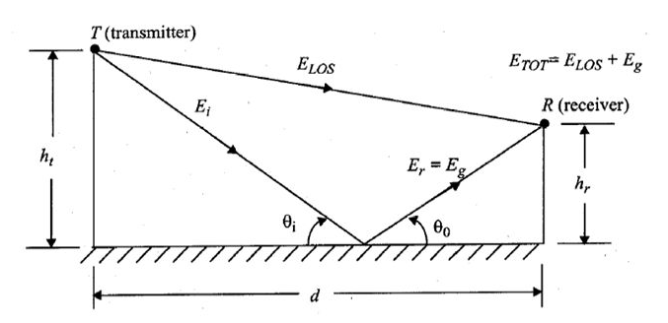
2-Ray Ground Reflection Model
Reasonably accurate for predicting
the large-scale signal strength over long distances (» km) for mobile systems that use tall towers (heights > 50 m)
line-of-sight microcell channels in urban environments
Notes:
Determine total received E-field, E_{tot}
Compute –
Path difference
Phase difference
Time delay
Evaluate E-field when reflected path arrives at receiver
Determine exact E-field for 2-ray ground model at distance d
Determine Received power

Slide 8
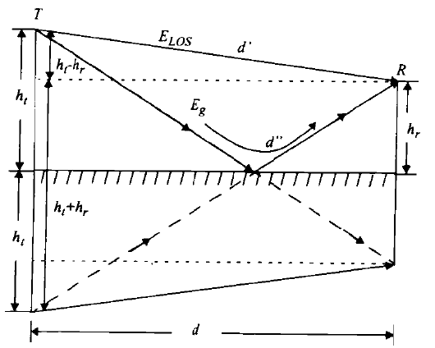
The method of images is used to find the path difference between the line-of-sight and the ground reflected paths.

Slide 9
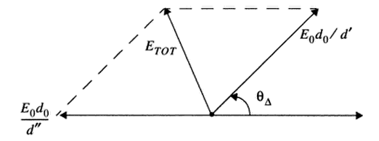
Phasor diagram showing the electric field components of the line-of-sight, ground reflected, and total received E-fields, derived from equation

Slide 10
Example 3.6: A mobile is located 5 km away from a base station and uses a vertical λ/4 monopole antenna with a gain of 2.55 dB to receive cellular radio signals. The E-field at 1 km from the transmitter is measured to be 10⁻³ V/m. The carrier frequency used for this system is 900 MHz. (a) Find the length and the gain of the receiving antenna. (b) Find the electric field and received power at the mobile using the 2-ray ground reflection model assuming the height of the transmitting antenna is 50 m and the receiving antenna is 1.5 m above ground.

Slide 11
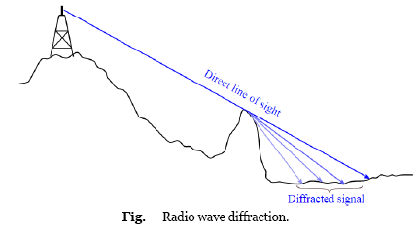
Diffraction
Diffraction allows radio signals to propagate around the curved surface of the earth and to propagate behind obstructions.
Based on Huygen’s principle, which says that all points on a wave front can be considered as point sources for the production of secondary wavelets.
Notes:
Although the received field strength decreases rapidly as the receiver moves deeper into the obstructed (shadowed) region, the diffraction field still exists and often has sufficient strength to produce a useful signal

Slide 12
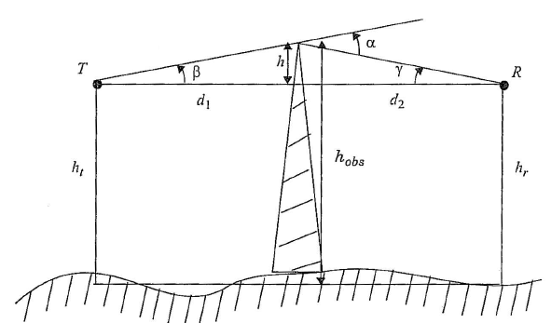
Knife Edge Diffraction Model
Estimating the signal attenuation caused by diffraction of radio waves over hills and buildings.
Consider a receiver at point R, located in the shadowed region (also called the diffraction zone). The field strength at point R is a vector sum of the fields due to all of the secondary Huygen's sources in the plane above the knife edge.
Notes:
Determine received E-field due to diffracted path
Compute –
Path difference
Phase difference
Time delay
The angle
Normalize with Fresnel-Kirchoff diffraction parameter
Determine exact E-field for different diffracted path
Diffraction Gain

Slide 13
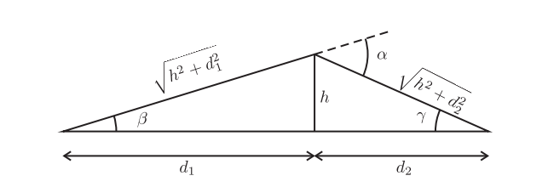
Knife Edge Diffraction Geometry (h_{t} = h_{r})

Slide 14
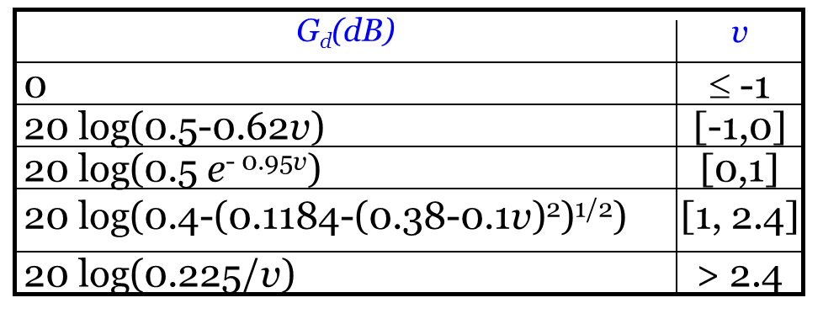
Diffraction Loss For Various Value of V

Slide 15
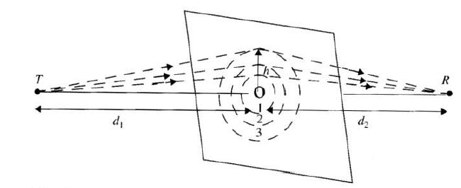
Fresnel zones
Fresnel zones represent successive regions where secondary waves have a path length from the TX to the RX which are nλ/2 greater in path length than of the LOS path.

Slide 16
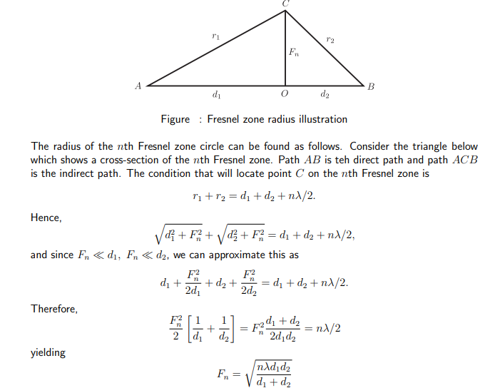
Notes:
Example:
If an obstacle is 10km away from a TX antenna and 2km away from RX antenna, find (a) the 1st Fresnel zone boundary for transmitting 900MHz signal.

Slide 17
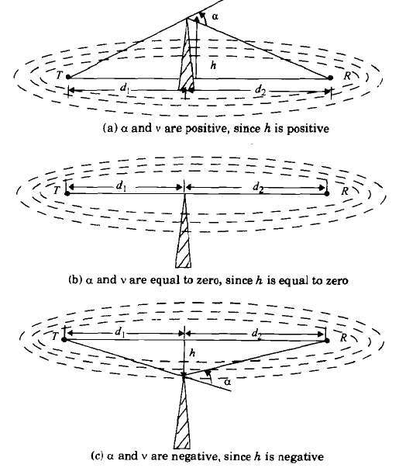
Three Cases:

Slide 18
Example 3.7
Compute the diffraction loss for the three cases. Assume λ=1/3m, d1 =1 km, d2 =1 km and (a)h =25m, (b)h =0, (c)h =-25m. For each of these cases, identify the Fresnel zone within which the tip of the obstruction lies.

Slide 19
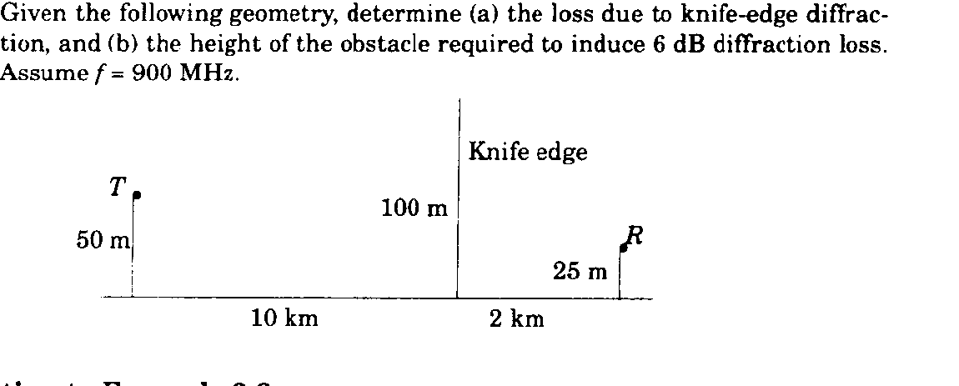
Example 3.8

